Slide 1

Barriers to Persistence in Competitive Programming Training Among Female Students: Why Many Start, But Few Continue
Shahed Bawadekji

Slide 2
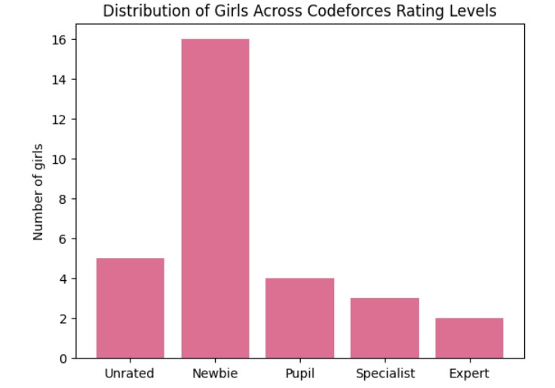
Distribution of Girls Across Rating Levels
The analysis shows that most girls fall into the Unrated and Newbie categories, while fewer students reach Pupil, Specialist, or Expert levels.

Slide 3
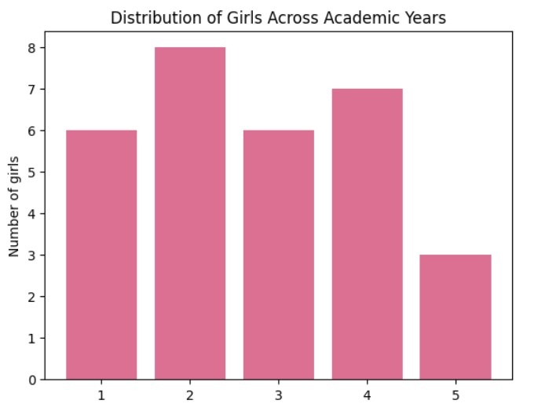
Distribution Across Academic Year
The data shows that most participants are from early academic years, while fewer girls are in advanced years.

Slide 4
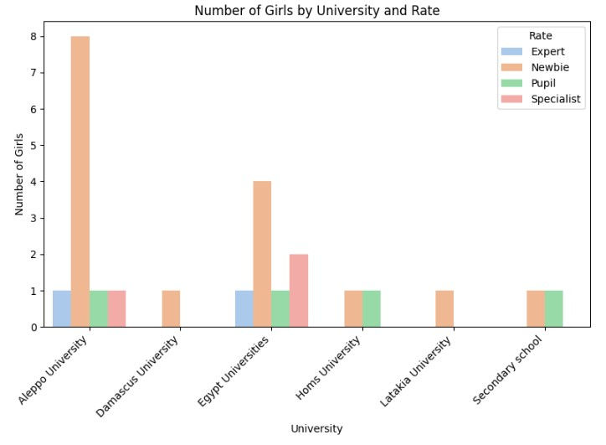
University & Rating Comparison:

Slide 5
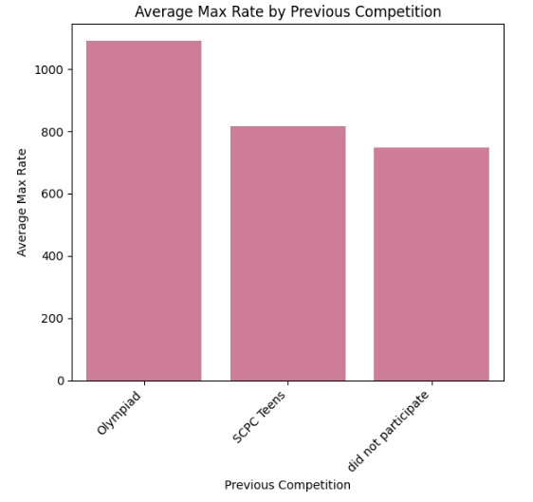
Average Max Rate by Previous Competition

Slide 6
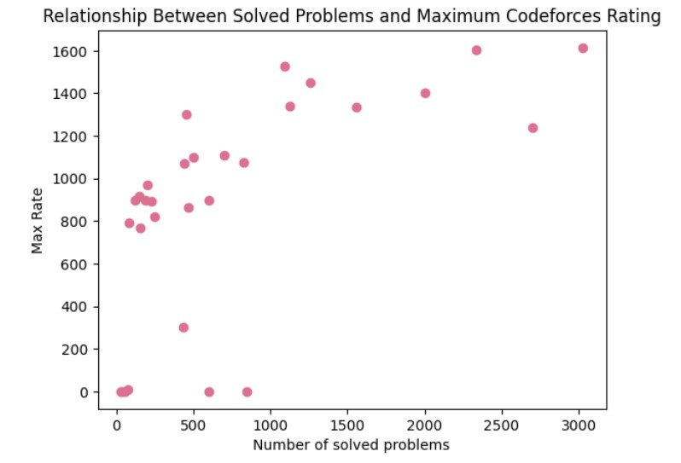
Relationship Between Solved Problems and Max Rate
The scatter plot shows a positive relationship between the number of solved problems and maximum rating. Students who solve more problems tend to achieve higher Codeforces ratings.

Slide 7
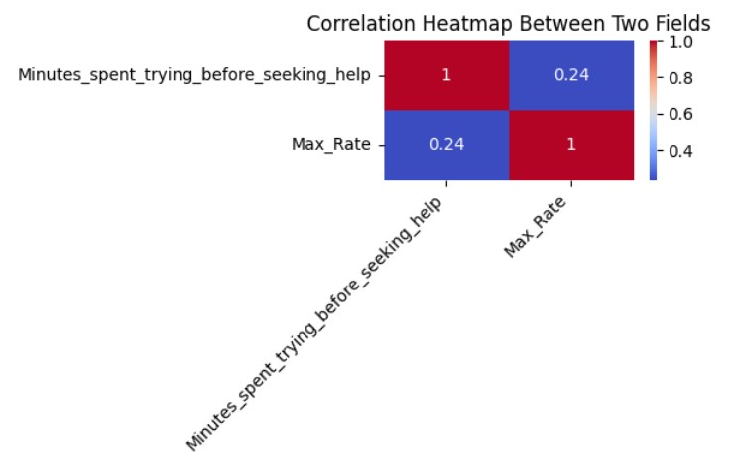
Correlation Analysis
A moderate positive relationship was observed between the time spent trying before asking for help and the highest rating on Codeforces. For reasons, this relationship may be affected by several confounding factors, including lack of participation in Codeforces contests, irregular training schedules, and others.

Slide 8
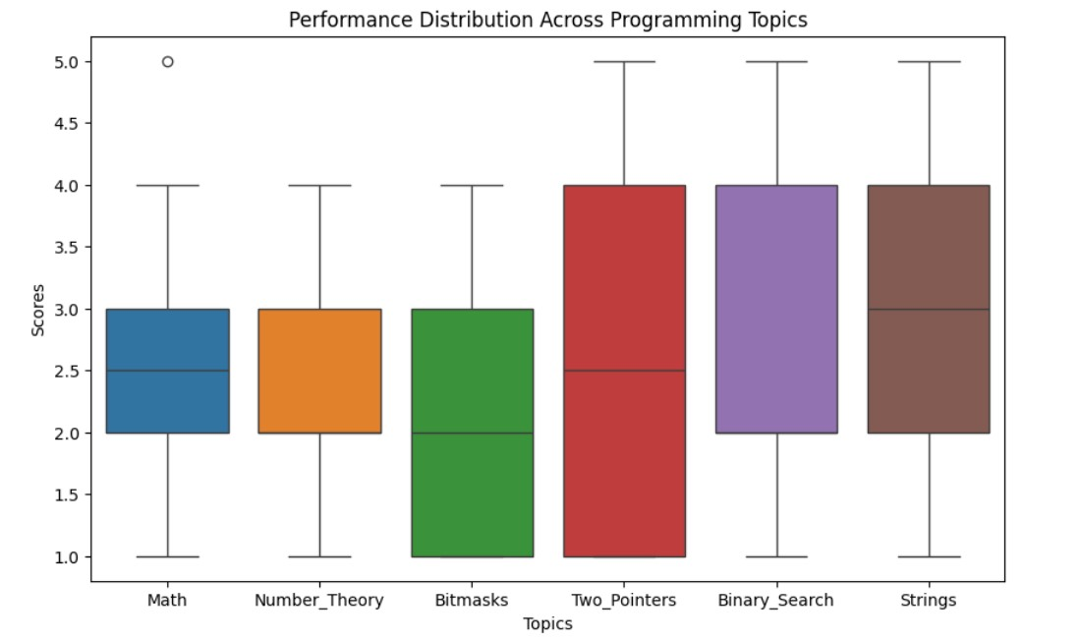
Topic Strength Analysis
Students performed best in Strings and Binary Search topics.
Bitmasks showed slightly lower average scores, suggesting this area may require more focus.

Slide 9
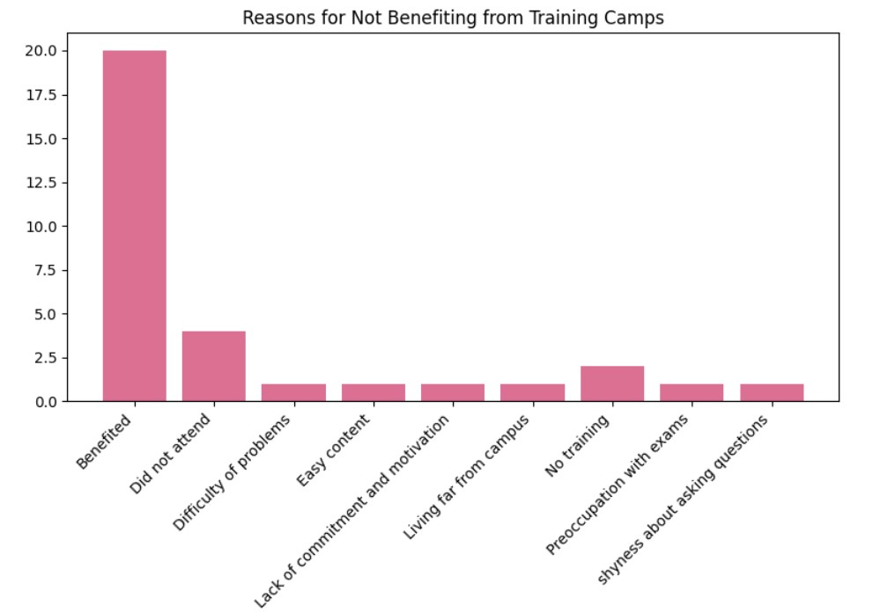
Reasons for Not Benefiting from Training Camps

Slide 10
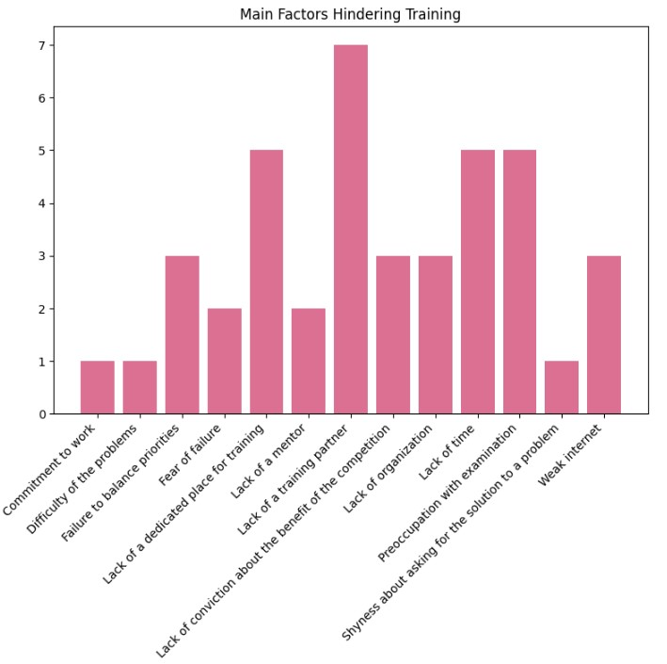
Reasons Hindering Training

Slide 11
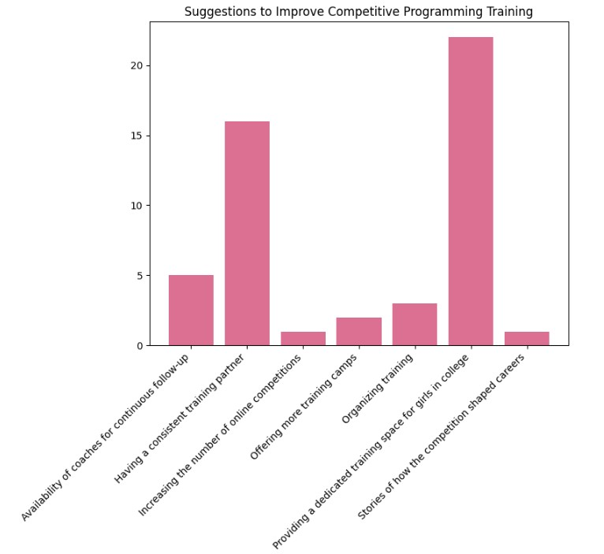
Suggestions to Improve Training

